Slide 1
Web Technology
Cloud Enabling Technology

Slide 2
What is cloud enabling Technology?
A set of primary technology components that collectively enable key features and characteristics associated with contemporary cloud computing is Cloud Enabling Technology.
• Broadband Networks and Internet Architecture
• Data Center Technology
• Virtualization Technology
• Web Technology
• Multitenant Technology
• Service Technology

Slide 3
Web Technology
Cloud computing relies on internet.
Web technology is very commonly used for cloud service implementations and for frontends used to remotely manage cloud-based IT resources.

Slide 4
Basic Web Technology
The World Wide Web is a system of interlinked IT resources that are accessed through the Internet.
The two basic components of the Web are the Web browser client and the Web server.
Three fundamental elements comprise the technology architecture of the Web:
1. Uniform resource locator (URL)
2. Hypertext transfer protocol (HTTP)
3. Markup languages (HTML, XML)

Slide 5
Uniform Resource Locator (URL)
Commonly informally referred to as a web address.
A reference to a web resource that specifies its location on a computer network and a mechanism for retrieving it.
Example: http://www.example.com/index.html

Slide 6
Hypertext transfer protocol (HTTP)
Primary communication protocol used to exchange content
URLs are typically transmitted via HTTP.

Slide 7
Markup languages (HTML, XML)
Markup languages provide a means of expressing Web-centric data and metadata.
The two primary markup languages are:
1. HTML: which is used to express the presentation of Web pages.
2. XML: which allows for the definition of vocabularies used to
associate meaning to Web-based data via metadata.

Slide 8
Web Applications
A distributed application that uses Web-based technologies is typically considered a Web application.
These applications can be found in all kinds of cloud-based environments due to their high accessibility.

Slide 9
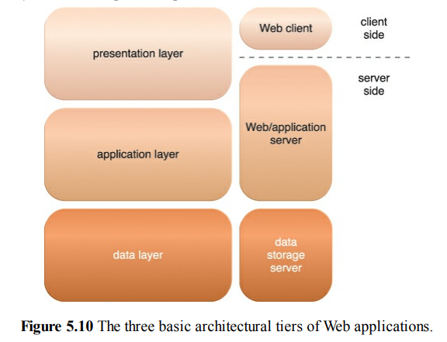

Slide 10
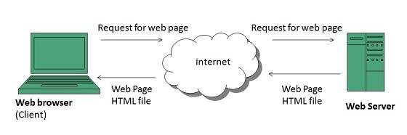
3 tier web architechture

Slide 11
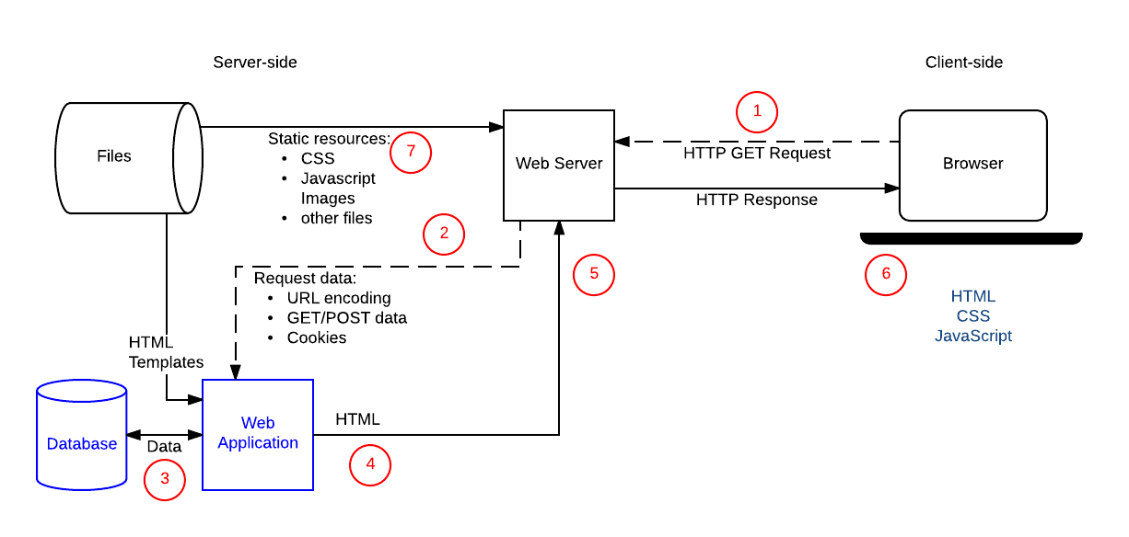
Overall view

